Slide 1
Trees & Binary Tree Session 09-10
Course : Data Structures
Effective Period : December 2018

Slide 2
Learning Outcomes
At the end of this session, students will be able to:
LO 1: Explain the concept of data structures and its usage in Computer Science
LO 2: Illustrate any learned data structure and its usage in application
LO 3: Apply data structures using C

Slide 3
Outline
Tree Introduction
Tree Concept
Binary Tree Concept
Type of Binary Tree
Property of Binary Tree
Expression Tree Concept
Threaded Binary Tree Concept

Slide 4
Tree Introduction
A tree is a non-linear data structure that represents the hierarchical relationships among the data objects
Some of the tree relations can be observed in directory structures or organizational hierarchies.
The node in the tree need no to be stored contiguously and can be stored anywhere and linked by pointers

Slide 5
Tree Concept
Node at the top is called as root.
A line connecting the parent to the child is edge.
Nodes that do not have children are called leaf.
Nodes that have the same parent are called sibling.
Degree of node is the total sub tree of the node.
Height/Depth is the maximum degree of nodes in a tree.
If there is a line that connects p to q, then p is called the ancestor of q, and q is a descendant of p.

Slide 6
Binary Tree Concept
Binary tree is a rooted tree data structure in which each node has at most two children.
Those two children usually distinguished as left child and right child.
Node which doesn’t have any child is called leaf.

Slide 7
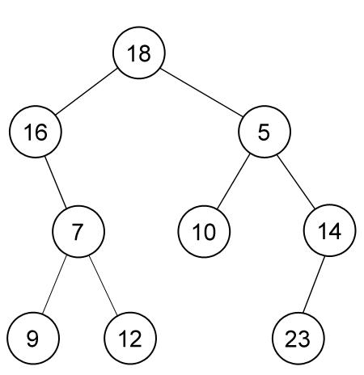
Binary Tree Concept
A sample of binary tree
of 9 nodes, rooted on
node which contains 18.
Leaves are nodes which
contain 9, 12, 10 and 23.

Slide 8
Type of Binary Tree
PERFECT binary tree is a binary tree in which every level are at the same depth.
COMPLETE binary tree is a binary tree in which every level, except possibly the last, is completely filled, and all nodes are as far left as possible. A perfect binary tree is a complete binary tree.
SKEWED binary tree is a binary tree in which each node has at most one child.
BALANCED binary tree is a binary tree in which no leaf is much farther away from the root than any other leaf (different balancing scheme allows different definitions of “much farther”).

Slide 9
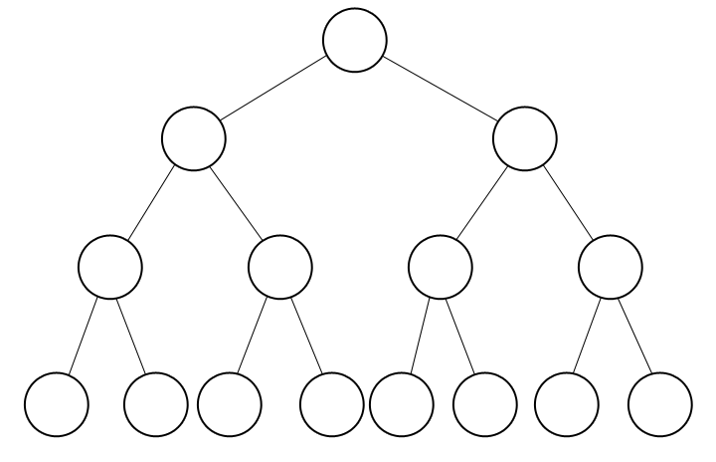
PERFECT Binary Tree

Slide 10
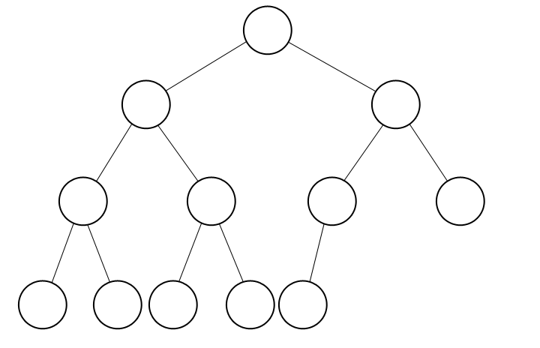
COMPLETE Binary Tree
A perfect binary tree is also a complete binary tree.

Slide 11
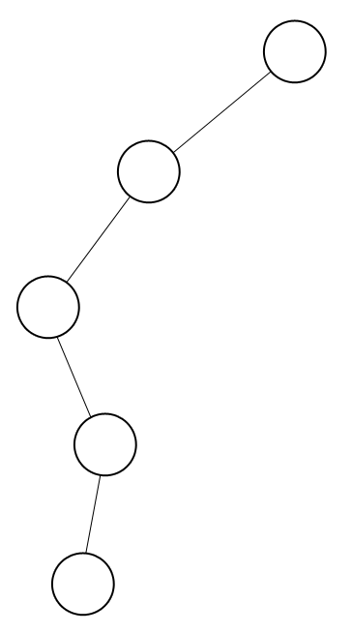
SKEWED Binary Tree

Slide 12
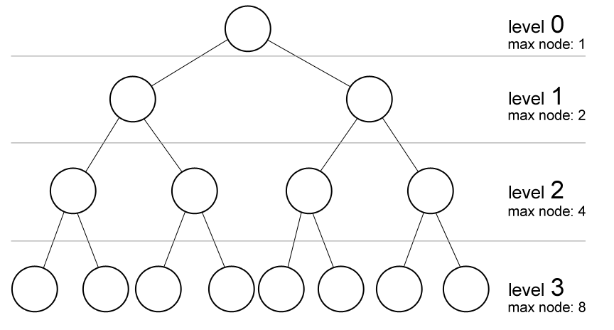
Property of Binary Tree
Maximum number of nodes on level k of a binary tree is 2^{k}.
In some literatures,
level of binary tree
starts with 1 (root).

Slide 13
Property of Binary Tree
Maximum number of nodes on a binary tree of height h is 2^{h+1} - 1.
Height of a tree is the total number of levels (excluding the root) or the highest level h (if the levels of a tree are: 0, 1, 2, …, h)
The following figure below has the height of: 3
Maximum nodes
of a binary tree of
height 3
= 1 + 2 + 4 + 8
= 2⁰ + 2¹ + 2² + 2³
= 2⁴ – 1
= 15

Slide 14
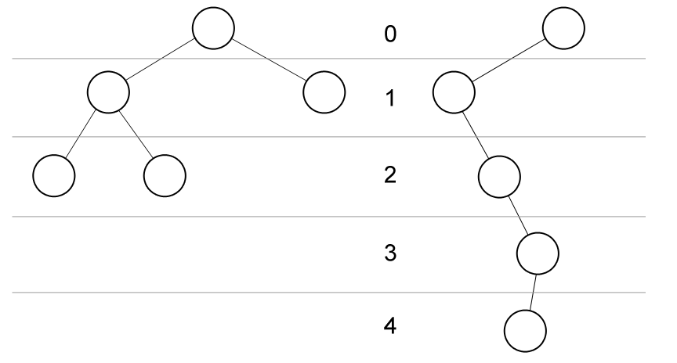
Property of Binary Tree
Minimum height of a binary tree of n nodes is ²log(n).
Maximum height of a binary tree of n nodes is n - 1.
Skewed binary trees
have maximum height

Slide 15
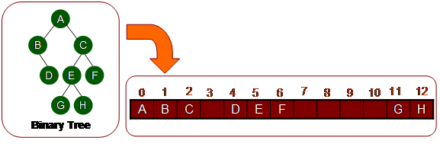
Representation of Binary Tree
Implementation using array
Index on array represents node number
Index 0 is Root node
Index Left Child is 2p + 1, where p is parent index
Index Right Child is 2p + 2
Index Parent is (p-1)/2

Slide 16
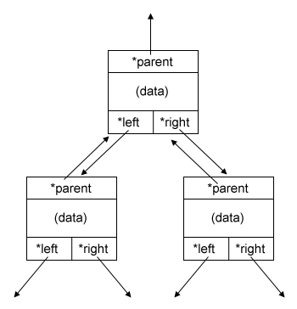
Representation of Binary Tree
Implementation using linked list
struct node {
int data;
struct node *left;
struct node *right;
struct node *parent;
};
struct node *root = NULL;

Slide 17
Expression Tree Concept
Recall our discussion on stack application about arithmetic notation
Here we will discuss such arithmetic notation using expression tree.

Slide 18
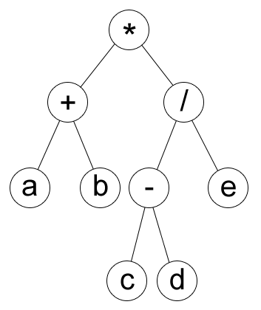
Expression Tree Concept
Prefix : *+ab/-cde
Postfix : ab+cd-e/*
Infix : (a+b)*((c-d)/e)

Slide 19
Expression Tree Concept
We will use this structure for each node in the tree:
struct tnode {
char chr;
struct tnode *left;
struct tnode *right; };
It is a binary tree.

Slide 20
Create Expression Tree from Prefix
We can create an expression tree from a prefix by recursive.
char s[MAXN];
int p = 0;
void f(struct tnode *curr) {
if ( is_operator(s[p]) ) {
p++; curr->left = newnode(s[p]);
f(curr->left);
p++; curr->right = newnode(s[p]);
f(curr->right);
} }
main function
struct tnode *root = newnode(s[0]);
f(root);

Slide 21
Prefix Traversal
Doing a prefix or postfix traversal in an expression tree is simple.
void prefix(struct tnode *curr) {
printf( “%c “, curr->chr );
if ( curr->left != 0 ) prefix(curr->left);
if ( curr->right != 0 ) prefix(curr->right); }
In prefix, you have to print/process before its child are processed.

Slide 22
Postfix Traversal
void postfix(struct tnode *curr) {
if ( curr->left != 0 ) postfix(curr->left);
if ( curr->right != 0 ) postfix(curr->right); printf( “%c“, curr->chr );
}
In postfix, you have to print/process after its child have been processed.

Slide 23
Infix Traversal
How about infix? Can we just do like this code below?
void infix(struct tnode *curr) {
if ( curr->left != 0 ) infix(curr->left);
printf( “%c“, curr->chr );
if ( curr->right != 0 ) infix(curr->right); }

Slide 24
Infix Traversal
It’s seems right, but infix may have operator precedence ambiguity without brackets.
For example * + a b c in prefix will be encoded in infix as a + b * c with the previous code, while the correct infix is (a + b) * c.
a + b * c : b is multiplied by c and then added by a
(a + b) * c : a is added by b and then multiplied by c

Slide 25
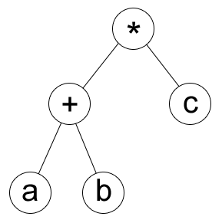
Infix Traversal
Prefix : *+abc
Postfix : ab+c*
Wrong infix : a+b*c
Correct infix : (a+b)*c

Slide 26
Infix Traversal
To fix that, we can add brackets () when expanding an operator.
void infix(tnode *curr) {
if ( is_operator(curr->chr) ) putchar( '(' );
if ( curr->left != 0 ) infix(curr->left);
printf( "%c", curr->chr );
if ( curr->right != 0 ) infix(curr->right);
if ( is_operator(curr->chr) ) putchar( ')' );
}
So * + a b c in prefix will be encoded as ((a + b) * c) in infix, which is correct.

Slide 27
Create Exp-Tree from Postfix
Now, can you create an expression tree given a postfix notation?
Hint: scan from right to left.

Slide 28
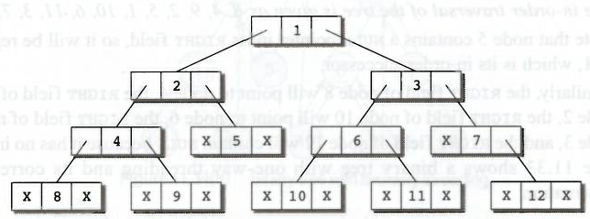
Threaded Binary Tree Concept
A threaded binary tree is same as that of a binary tree but with a difference in storing NULL pointers.
Binary Tree:

Slide 29
Threaded Binary Tree Concept
In the linked representation, a number of nodes contain a NULL pointer either in their left or right fields or in both.
This space that is wasted in storing a NULL pointer can be efficiently used to store some other useful peace of information.

Slide 30
Threaded Binary Tree Concept
For example, the NULL entries can be replaced to store a pointer to the in-order predecessor, or the in-order successor of the node.
These special pointers are called thread and binary trees containing thread are called threaded trees.
In the linked representation of a threaded binary tree, threads will be denoted using dotted lines

Slide 31
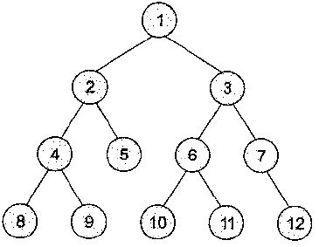
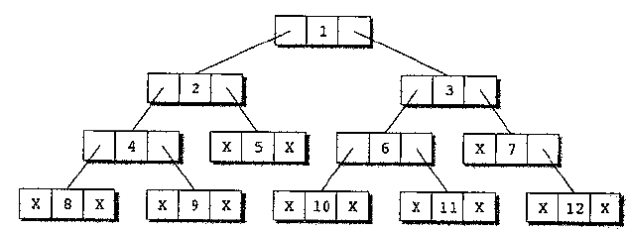
Threaded Binary Tree Concept
← Binary Tree without threading
Linked →
representation of
the binary tree

Slide 32
Threaded Binary Tree Concept
In one way threading, a thread will appear either in the right field or the left field of the node.
A one way threaded tree is also called a single threaded tree.
If the thread appears in the left field, then the left field will be made to point to the in-order predecessor of the node.
Such a one way threaded tree is called a left threaded binary tree.
On the contrary, if the thread appears in the right field, then it will point to the in-order successor of the node. Such a one way threaded tree is called a right threaded binary tree.

Slide 33
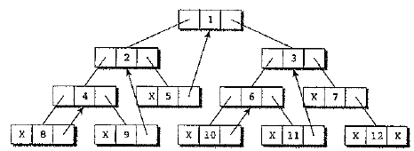
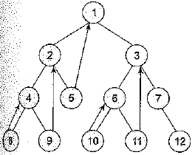
Threaded Binary Tree Example
Binary tree with
one-way
threading

Slide 34
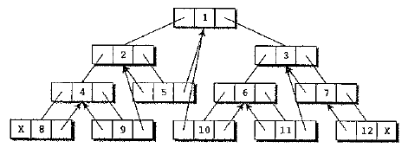
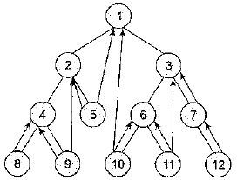
Threaded Binary Tree Example
Binary tree with
two-way
threading

Slide 35
Advantages
It enables linear traversal of elements in the tree
Linear traversal eliminates the use of stacks which in turn consume a lot of memory space and computer time
It enables to find the parent of a given element without explicit use of parent pointers
Since nodes contain pointers to in-order predecessor and successor, the threaded tree enables forward and backward traversal of the nodes as given by in-order fashion

Slide 36
References
S. Sridhar. 2015. Design and Analysis of Algorithms. Oxford University Press. New Delhi. ISBN: 9780198093695. Chapter 5
Reema Thareja. 2014. Data structures using C. Oxford University Press. New Delhi. ISBN:9780198099307. Chapter 9
Binary Trees, http://cslibrary.stanford.edu/110/BinaryTrees.html

